Slide 1

Team 4
Erica, Megan, Josh, Josh, Anthony
2024
Bing Bong

Slide 2

2024
Table Of Contents
Problem Statement
Solution
Github
Questions
C

Slide 3

2024
Problem Statement.

Slide 4

2024
Our Motivation
In many household environments, managing small trash items like wrappers, tissues, or snack packets can be inconvenient, often leading to clutter or the need for multiple trips to a trash bin. This issue is particularly acute for individuals with mobility issues, small children, or busy lifestyles. Traditional waste management solutions in homes do not cater to the need for immediate, portable, and accessible trash disposal. Moreover, the absence of an immediate disposal method can lead to littering or the accumulation of waste in inappropriate places.

Slide 5
2024
Solution.

Slide 6

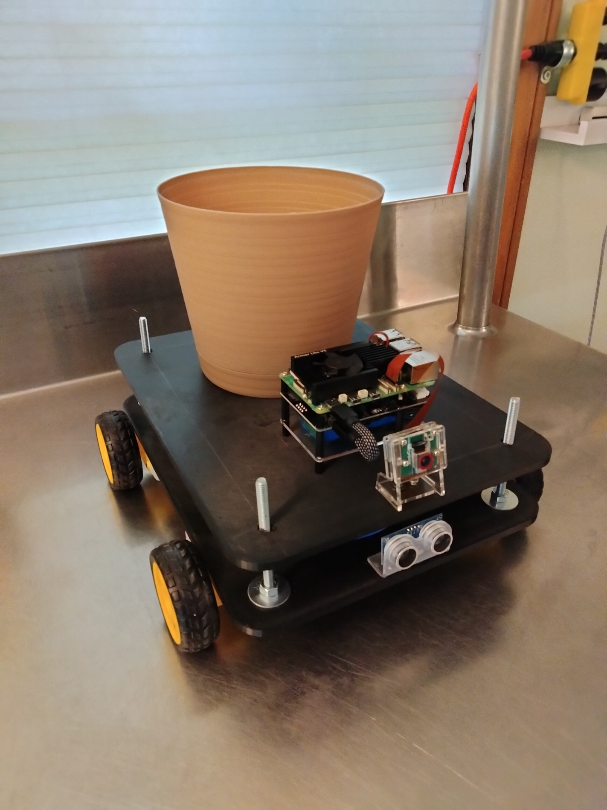
2024

Slide 7
2024
Human Detection
Trash Accumulation Detection
Tensorflow
Using TensorFlow our team used sophisticated models for human detection, leveraging its vast array of tools and pre-trained models like SSD and Faster R-CNN. By training these models on large datasets of human images, TensorFlow can learn to accurately identify and locate humans across various environments and poses. The flexibility and efficiency of TensorFlow API enables rapid development and deployment of human detection systems.
Pressure sensor
Bing Bong, utilizes pressure sensors to accurately measure its internal load, enabling it to determine the amount of trash it contains based on weight. This feature allows Bing Bong to optimize its collection routes and notify operators when it's time to empty its contents, enhancing efficiency in waste management.
Object Avoidance
App
Proximity Sensors
Bing Bong is equipped with proximity sensors which can navigate environments autonomously by detecting walls and objects in its path, using these sensors to measure the distance to nearby obstacles. By processing the data from these sensors, Bing Bong can dynamically adjust its trajectory to avoid collisions, ensuring smooth and safe operation in complex spaces.
Android App
Bing Bong is engineered to seamlessly interface with an Android app, allowing users to control it directly from their smartphones with intuitive commands and settings adjustments. This connectivity enables users to turn on or off Bing Bong, whether to follow or a person or not and informs the user of Bing Bongs battery percentage.

Slide 8
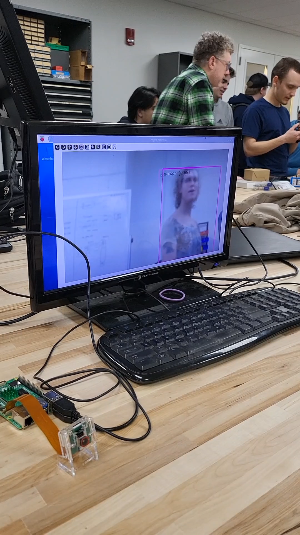
2024
This how our human detection works. The model is in the TensorFlow lite format. We use an optimized object detection model. It detects many objects, more than just people. The results are then filtered to box only the closest person. This model runs on the Raspberry Pi 5 and runs when we turn on the Raspberry Pi.

Slide 9
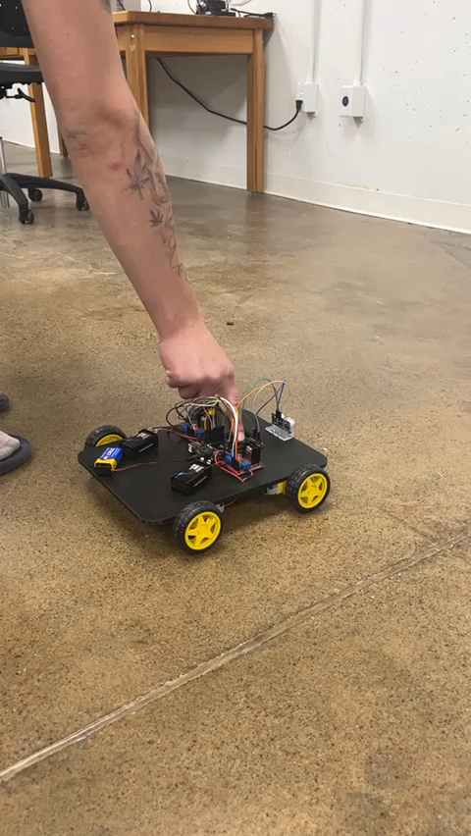
2024
Object avoidance is accomplished with an ultrasonic sensor that sends data to the Arduino. This sensor sends a PWM signal. The length of time the PWM signal is high multiplied by the velocity of sound is the distance to the object. When an object is found at 4 inches or less the motors are stopped.

Slide 10
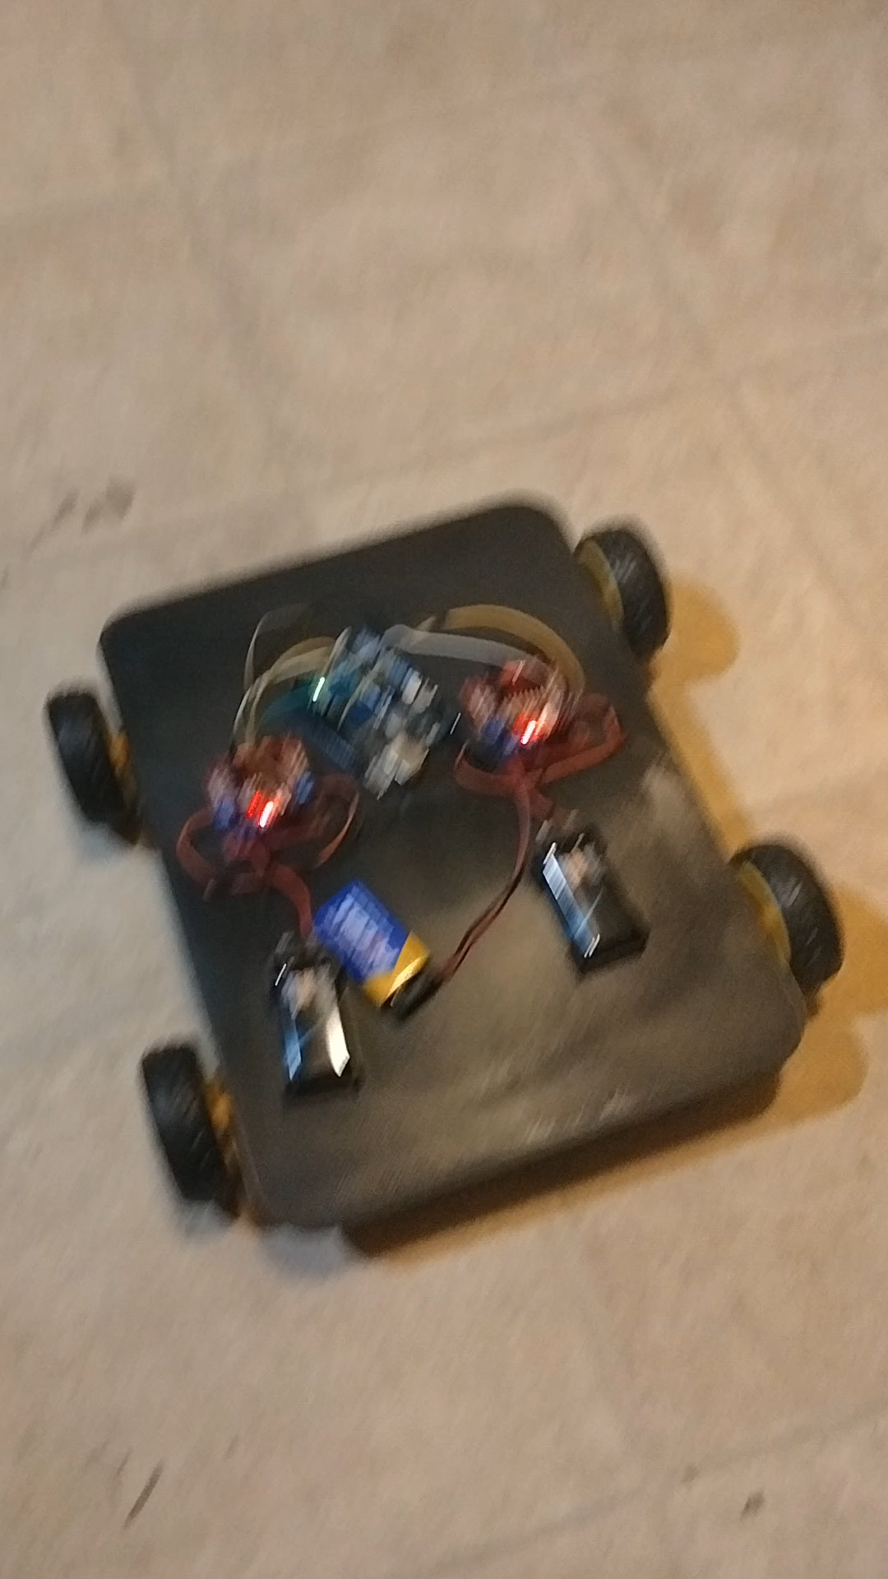
2024
Each pair of motors are controlled by a motor control. The pairs being the motors on the right side and the motors on the left. The motor controller insures the motors don’t send a voltage spike to the Arduino. The design for the motor controller includes an H bridge. The H bridge controls the direction the motor spins. Each motor gets a unique PWM signal from the arduino. This controls the speed. To turn, each pair of motors spins the same in an opposite direction from the other pair of motors.

Slide 11
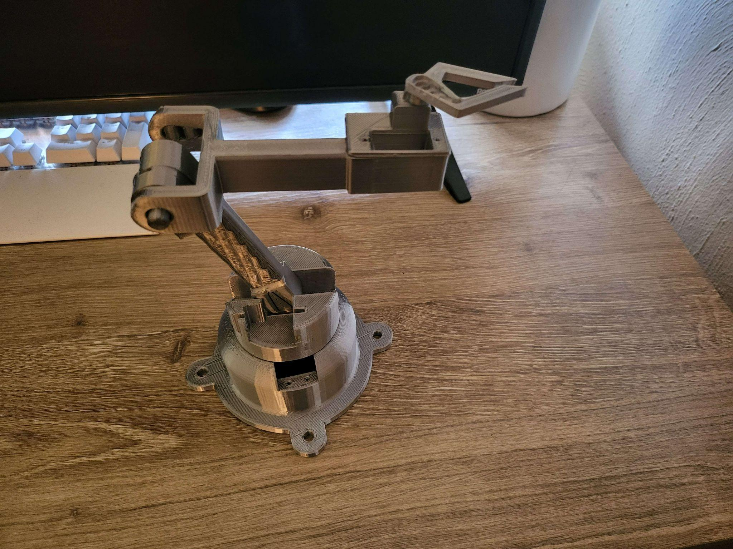
2024
This is the trash arm. It will be used to dump the trash can. It is 3D printed. It is controlled by 3 motors, one for each section of the arm. It will be controlled by the Arduino.

Slide 12
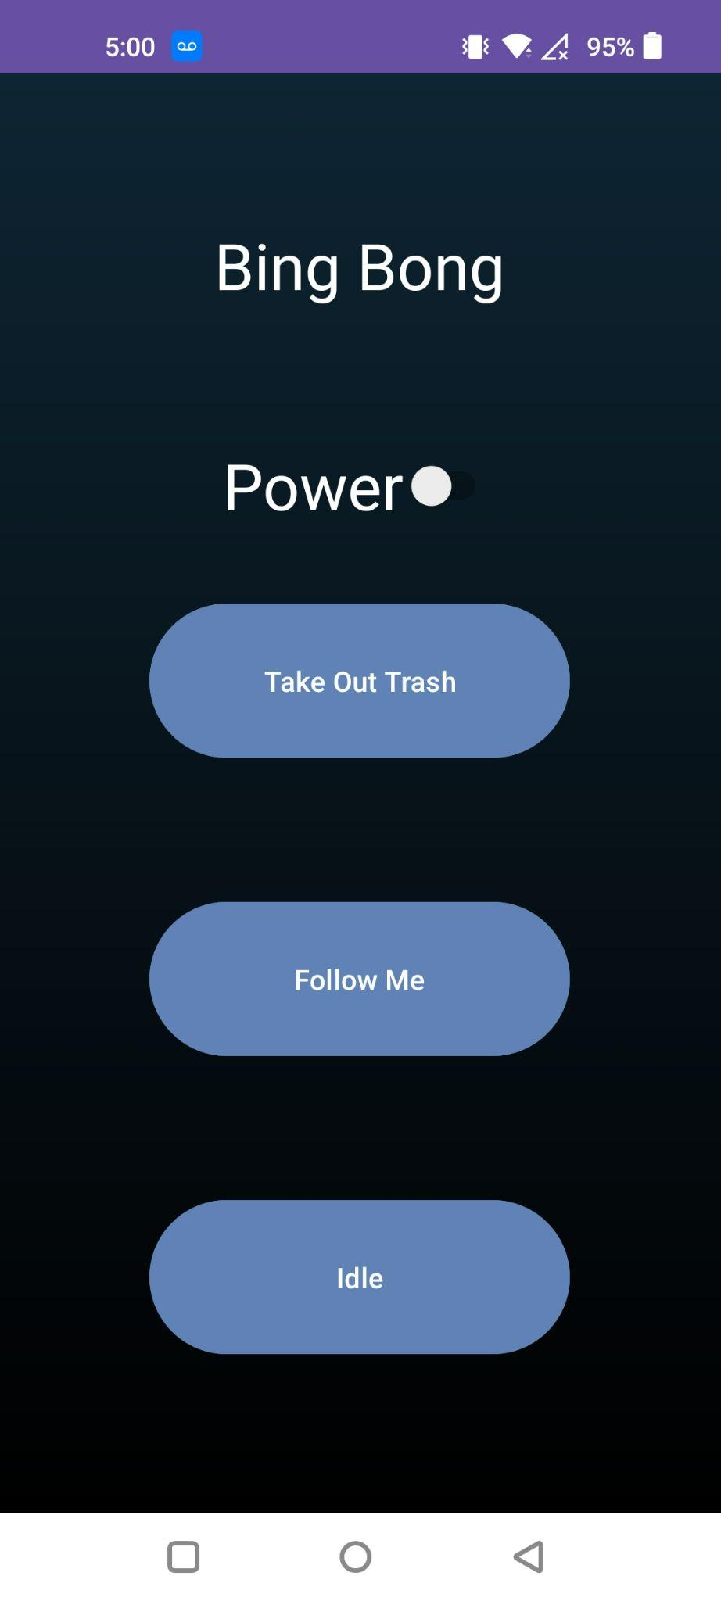
2024
This is our Android app. To use any of the buttons you must toggle the power switch. There are buttons for telling BingBong to take out the trash, to follow a person, and to idle. A tcp port is open on the Raspberry Pi that listens for these commands. We plan on executing the respective section of code on the Raspberry Pi when receiving the command from the Android app. To ensure the app can connect to the Raspberry Pi a hotspot is turned on on the phone and the raspberry pi configures itself to use the hotspot with a static IP and start the server. The android app then sends commands through it’s hotspot network to the static IP.

Slide 13
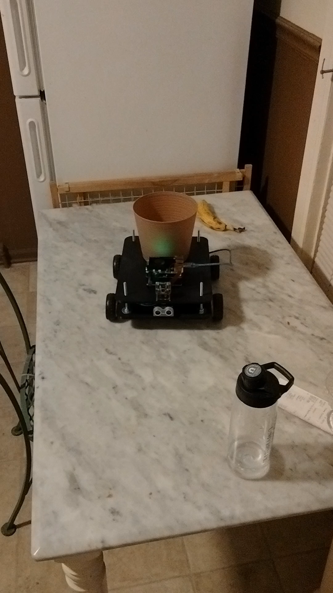
2024
Following a person is accomplished with a feedback loop. The output from the TensorFlow lite model on the Raspberry Pi is sent to the Arduino to update the motors. This done by using 3 zones; left, right, and center. Where the person is determines the zone they are in. The zone is then sent to the Arduino. The Arduino uses that information for the wheels. When the wheels turn the camera center is updated.

Slide 14
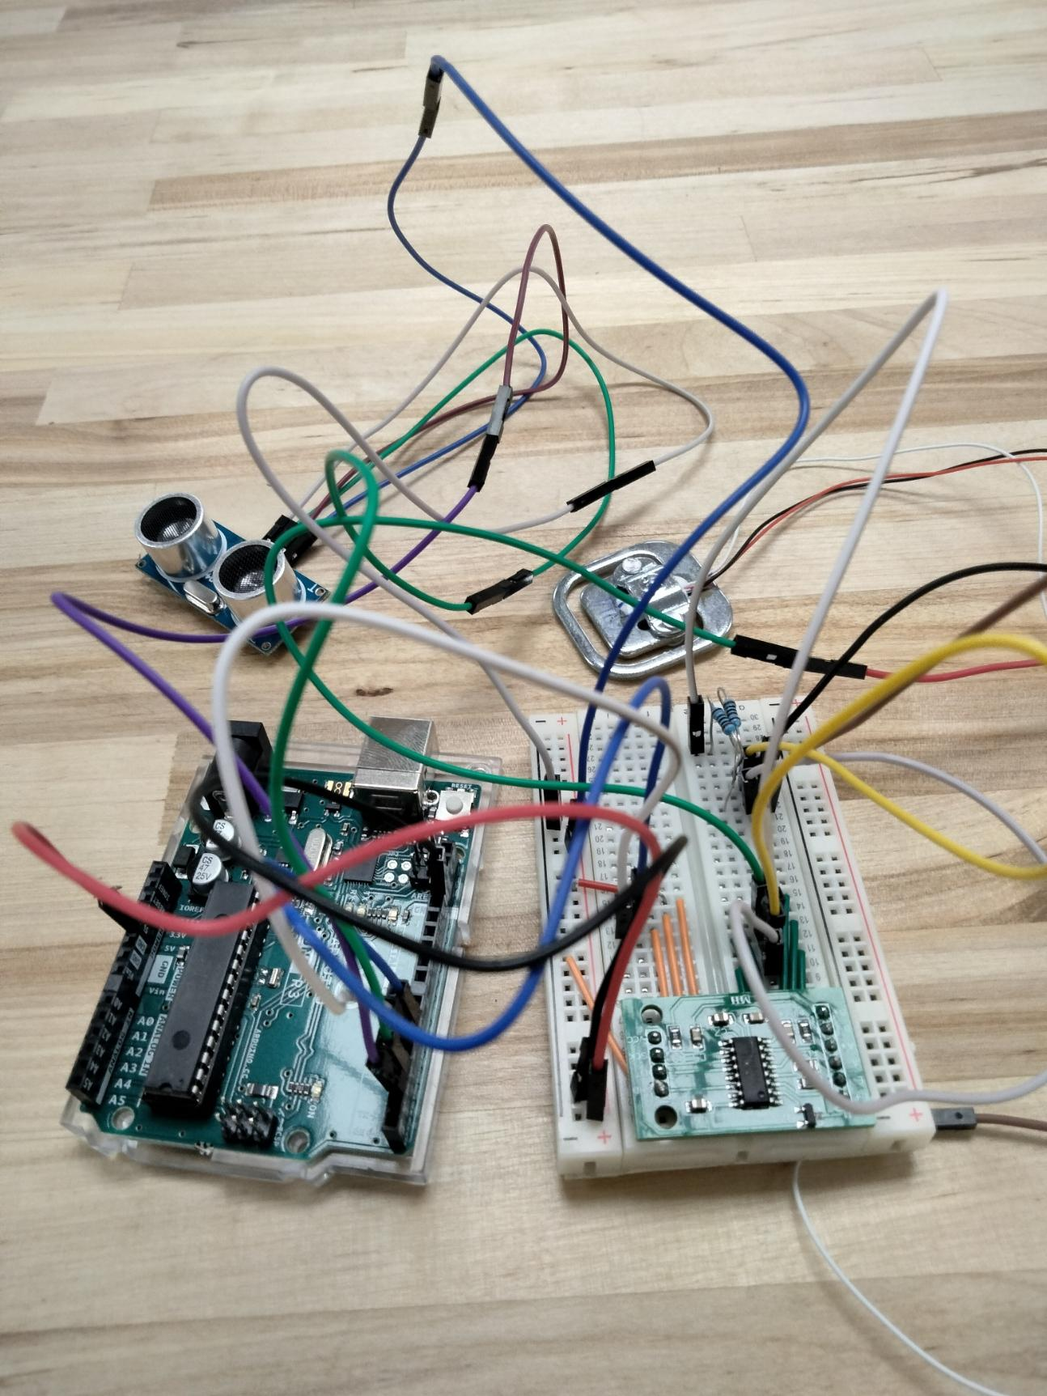
2024
The load cell and proximity sensor in the picture is used for full trash detection. When an object is in close proximity for a long time then the trash is full. Also when the trash weighs over a certain amount then the trash is full. The load cell is used to find the weight of the trash. The load cell must amplified by the amplifier seen in the picture. The amplifier also performs analog to digital conversion.

Slide 15

2024
GitHub.

Slide 16
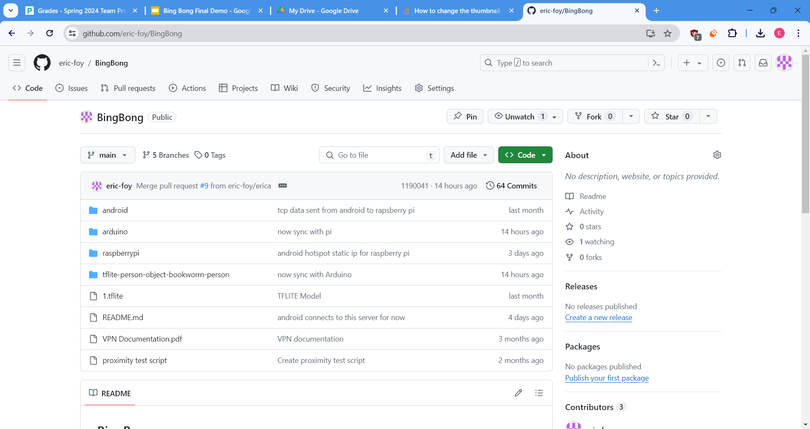
2024
We have 64 commits at the time of writing this. This repository is public and is hosted on GitHub. All team members made commits. The android folder contains the main java file for the app, the rest of the code is in another public repo linked to in the Readme. The feedback.ino file in the Arduino folder is the most important Arduino file. It is the code currently running on the Arduino. The detect_person.py file in the tflite-person-object-bookworm-person folder is the most important raspberry pi file. It runs the objection detection model.
https://github.com/eric-foy/BingBong

Slide 17
2024
Questions?

